Slide 1
Düslipideemia ravi tänapäev ning uued võimalused Eestis ja maailmas
Margus Viigimaa

Slide 2
Agressiivne lipiidelangetav ravi annab oluliselt parema tulemuse
30
1° prevention statin
4S-P
1° prevention placebo
25
20
2° prevention statin
Koronaaratakiga patsiendid (%)
4S-S
LIPID-P
2° prevention placebo
15
HPS-P
CARE-P
CARE-S
LIPS-P
10
HPS-S
LIPID-S
AtoZ 20
TNT 10
WOSCOPS-P
PROVE-IT A
PROVE-IT P
LIPS-S
WOSCOPS-S
5
TNT 80
ASCOT-P
AtoZ 80
AFCAPS-S
ASCOT-S
AFCAPS-P
0
50
70
90
110
130
150
170
190
210
mg/dL
Saavutatud LDL-kolesterool
Ballantyne CM. Am J Cardiol. 1998
O’Keefe JH et al, JACC 2004

Slide 3
REVERSAL: kuna tekib ateroomi regressioon?
Atorva 80 mg või Prava 40 mg (n=502)
20
15
10
5
Ateroomi mahu muutus, mm³
0
-5
-10
-15
-80
-70
-60
-50
-40
-30
-20
-10
0
10
20
LCL-C languse %
LDL-C 50%-line langus peatab ateroskleroosiprotsessi

Slide 4
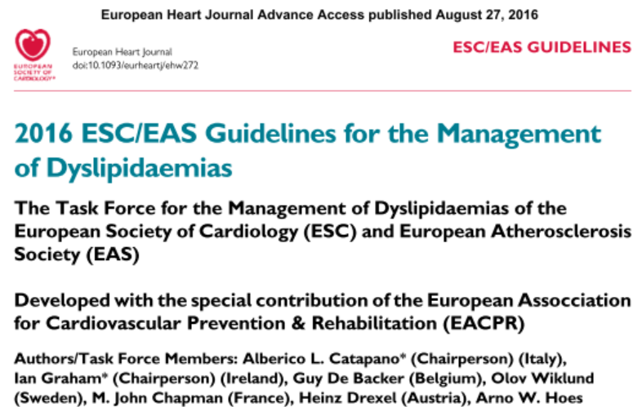

Slide 5
Meta-analüüs statiinide terapeutilisest ekvivalentsusest: LDL taseme vähenemine vs annused

Slide 11
Kuidas on olukord Eestis?

Slide 12
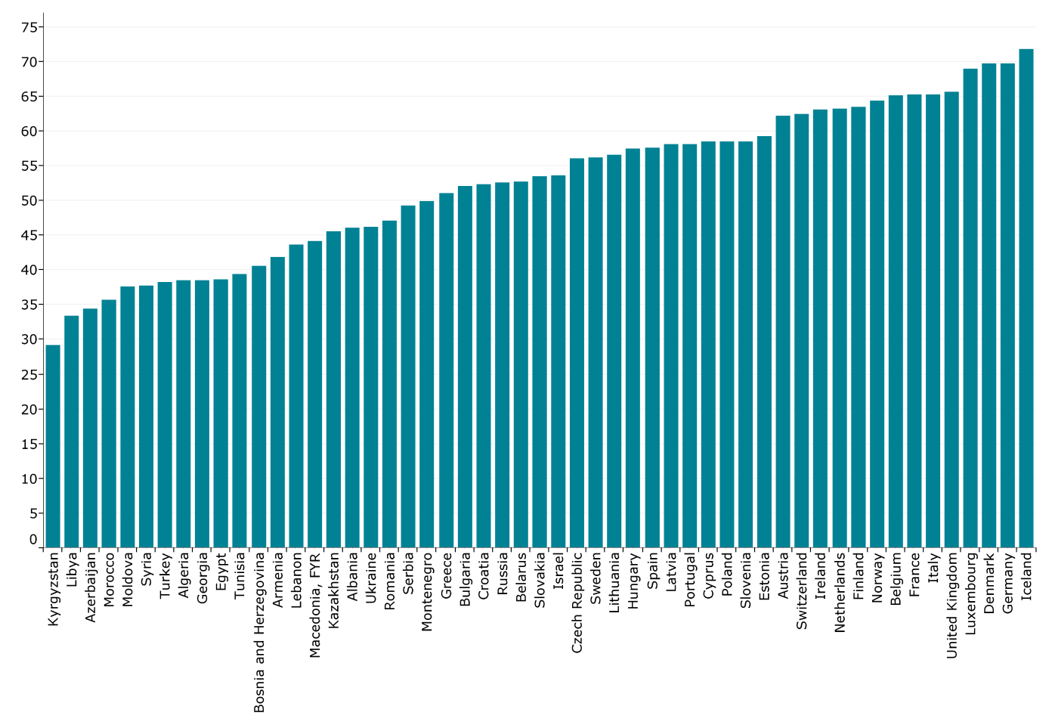
Prevalence of raised total cholesterol (≥ 5.0 mmol/L) (% population)
Copyright © ESC

Slide 13
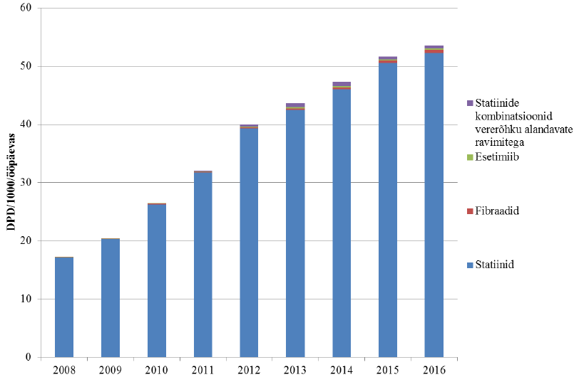
Lipiidelangetavate ravimite kasutamine Eestis 2008-2016

Slide 14
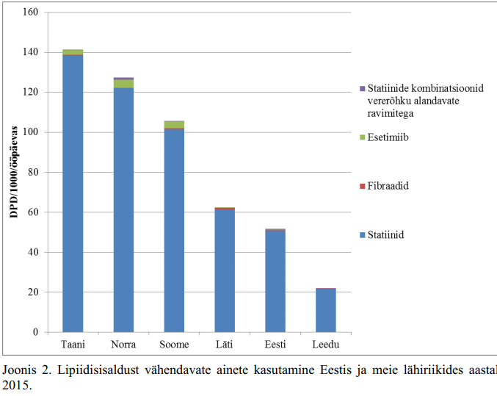
Lipiidelangetav ravi Eestis ja lähiriikides aastal 2015

Slide 15
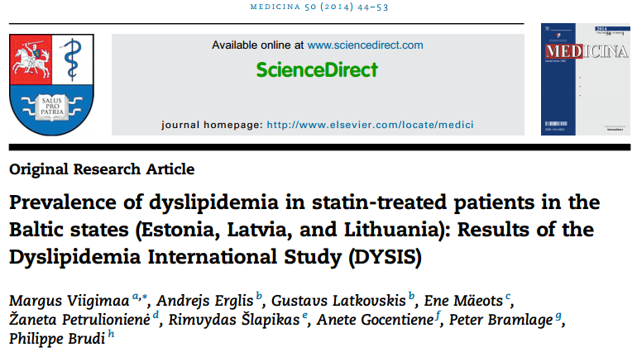

Slide 16
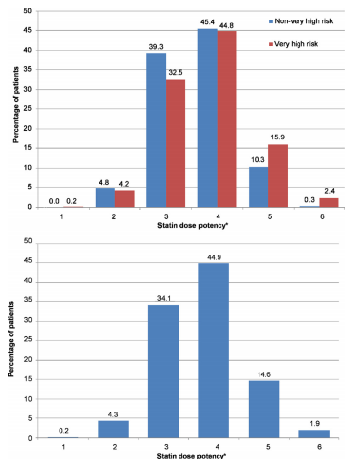

Slide 17
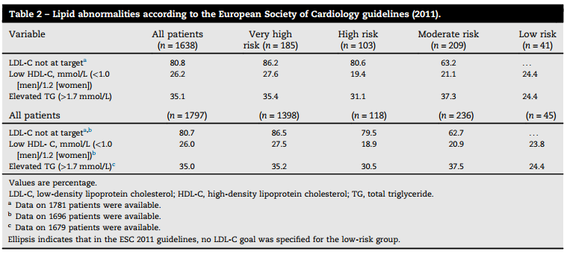

Slide 18
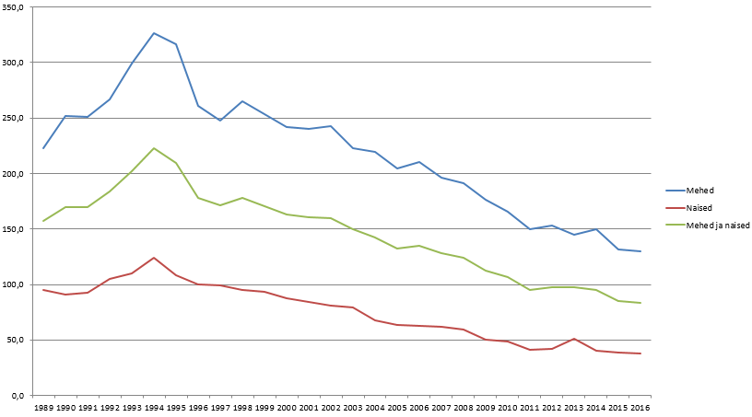
SVH suremus < 65 aastastel Eesti elanikel on langenud üle 50%

Slide 19
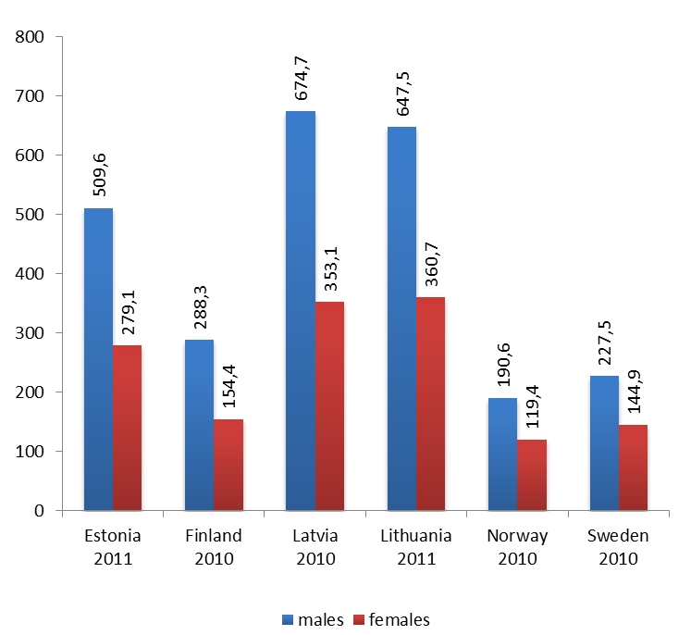
CVD mortality per 100 000 inhabitants aged <65 years in Nordic-Baltic countries

Slide 20
Kas me kasutame statiine liiga palju?

Slide 21
Statiinide kasutamine (OECD health statistics 2013)

Slide 22
Kolesterool on imetajatel rakutegevuse jaoks hädavajalik aine.
ÕIGE! Aga mis tasemel?

Slide 23
LDL-kolesterool imetajatel
mg/dl
mmol/L
4,5
160
4
3,5
120
3
2,5
80
2
1.5
Vastsündinu
Hiina
farmer
40
Kaamel
Koer
1
Rott
Siga
Hamster
Kass
0,5
0

Slide 24
LDL-kolesterool imetajatel
mg/dl
mmol/L
4,5
160
4
Eurooplane
3,5
120
3
2,5
80
2
1.5
Vastsündinu
Hiina
farmer
40
Kaamel
Koer
1
Rott
Siga
Hamster
Kass
0,5
0

Slide 26
1. Statiinid vähendavad efektiivselt KV suremust 2. On ohutud (vähkasvajad, mittevaskulaarsed haigused)

Slide 27
Statiinid langetavad oluliselt dementsuse riski mustanahalistel ameeriklastel
Ethn Dis. 2015; 25(3): 345–354.
Published online 2015 Aug 7.

Slide 28
Statiiniuuringud: väga madal LDL-kolesterool ei põhjusta lisakõrvaltoimeid
PROVE-IT TIMI 22¹
JUPITER²
IMPROVE-IT³
Uuringu-ravim
Atorvastatin 80 mg vs pravastatin 40 mg
Rosuvastatin 20 mg vs placebo
Simvastatin 40 mg ± ezetimibe 10 mg
CVD
anamnees
Jah
Ei
Ei
≤40 mg/dL
>40–60 mg/dL
>60–80 mg/dL
>80–100 mg/dL
<50 mg/dL
>50 mg/dL
<30 mg/dL
30–50 mg/dL
50–70 mg/dL
≥70 mg/dL
LDL-C
grupid
Hemorrhagic stroke, liver-related events, muscle-related events, retinal AEs, trauma/suicide, study drug discontinuation due to AEs
All treatment-emergent AEs
Study drug discontinuation due to AEs, myalgias with CK↑, hemorrhagic stroke, AST/ALT >3x, neuro-cognitive AEs, gall bladder AEs, cancer, CHF causing hospitalization, non-CV death
Kõrvaltoimed
Erinevate LDL-C tasemetega grupides kõrvaltoimete sagedus ei erinenud
[To convert, 100 mg/dL=2.59 mmol/L].
AE, adverse event; ALT, alanine aminotransferase; AST, aspartate aminotransferase; CHF, congestive heart failure; CK, creatine kinase; CV, cardiovascular; CVD, cardiovascular disease; LDL-C, low-density lipoprotein cholesterol.
1. Wiviott SD, et al. J Am Coll Cardiol 2005;46:1411–6; 2. Hsia J, et al. J Am Coll Cardiol 2011;57:1666–75; 3. Giugliano RP, et al. Presented at European Society of Cardiology, London, 2015.
Notes:
PROVE-IT TIMI 22¹
In patients treated with intensive LLT, there did not seem to be a relationship between achieved LDL-C levels and the likelihood of adverse safety events
There were no trends toward increases in the rates of expected side effects such as myopathy or elevations in liver enzyme levels based on achieved LDL-C levels
Rates of anticipated adverse events, such as elevations in liver and muscle enzymes seen in the PROVE IT-TIMI 22 trial, are consistent with previous data
JUPITER²
Myalgia and diabetes mellitus were somewhat more common among participants attaining LDL-C <50 mg/dL, but these rates were not significantly different from rates among patients not attaining LDL-C <50 mg/dL
Rates of other adverse events, including muscle weakness, myopathy, neuropsychiatric events, renal dysfunction, hemorrhagic stroke, and cancer, were not higher among patients allocated to rosuvastatin than among participants allocated to placebo, regardless of attained LDL-C level
IMPROVE-IT³
No differences in the frequency of myalgia with an increase in CK levels, AEs leading to discontinuation, AST or ALT >3 x ULN, gall bladder AEs or neurocognitive AEs were observed in patients with different levels of LDL-C at 1 month (<30, 30–50, 50–70 or ≥70 mg/dL)
Abbreviations:
AE, adverse event; ALT, alanine aminotransferase; AST, aspartate aminotransferase; CK, creatine kinase; CV, cardiovascular; LDL-C, low-density lipoprotein cholesterol; LLT, lipid lowering therapy.
References:
Wiviott SD, et al. J Am Coll Cardiol 2005;46:1411–6.
Hsia J, et al. J Am Coll Cardiol 2011;57:1666–75.
Giugliano RP, et al. Presented at European Society of Cardiology, London, 2015.

Slide 29
Miks me ei usu madala LDLi kahjustavat toimet?
Kõik koed sünteesivad ise kolesterooli.
Aju lipoproteiinide süntees on sõltumatu tsirkuleerivatest lipoproteiinidest.
PCSK9 inhibiitorid ei vähenda kolesterooli sünteesi vaid suurendavad selle tagasihaaramist maksa.
Homosügootsetel PCSK9 defitsiidiga haigetel on on LDL-C tase 0,3-0,5 mmol/L.

Slide 30
Statiinide talumatus

Slide 31
Statiintolerantsi liigid
Täielik - 3 statiini on algannuses osutunud talumatuteks
Osaline – eesmärkvaäärtuste saavutamiseks vajalik kõrge statiinidoos pole kasutatav

Slide 32
Statiinide talumatuse raskendajad/tekitajad
Eelnevad lihashaigused/sümptoomid
D-vitamiini ja Q10 koensüümi puudus
Suur kehaline koormus
Diabeet, hüpotüreoidism, maksa- ja neerupuudulikkus
Ravimid (amiodaroon, verapamiil, makroliidid, gemfibrosiil jt)
Naissugu, kõrge vanus
Madal KMI
Alkoholi kuritarvitamine, greibimahl

Slide 33
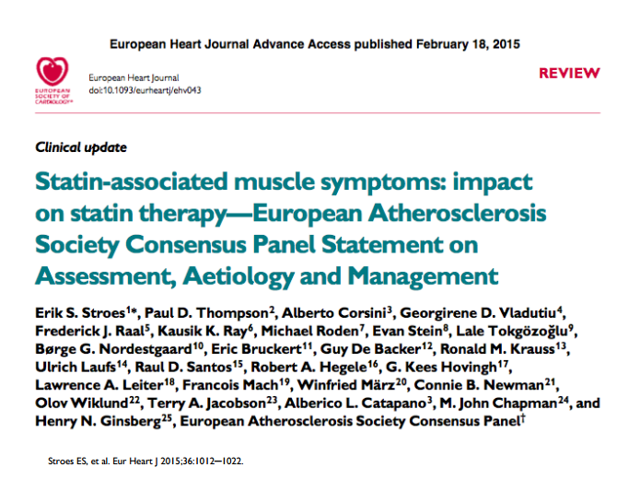

Slide 35
Kas fibraatidel on endiselt kohta düslipideemia ravis?

Slide 36
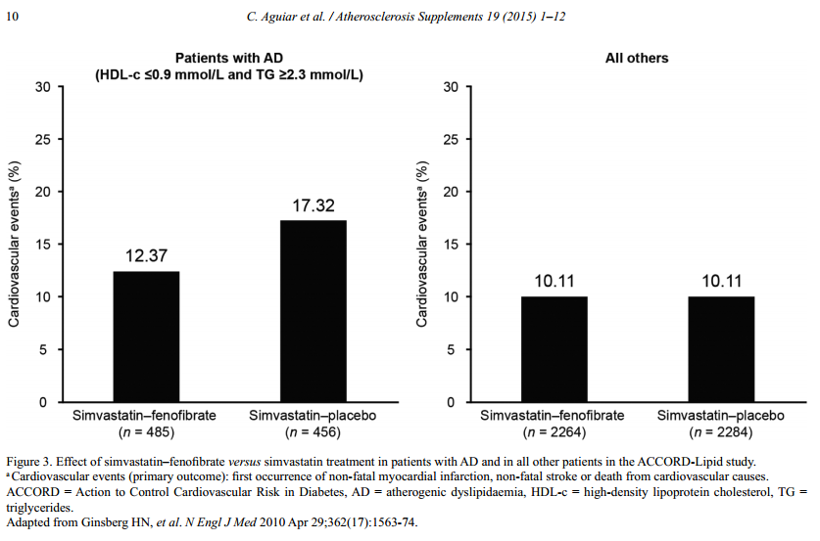

Slide 37
Revolutsioon ateroskleroosi ravis: PCSK9 inhibiitorid

Slide 38
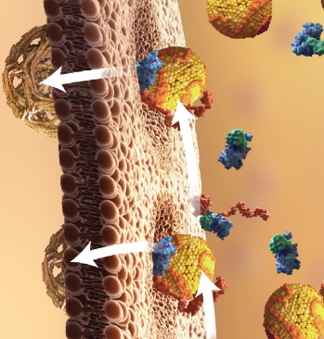
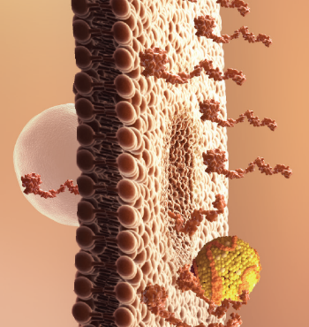
PCSK9 inhibitsioon suurendab LDL-retseptorite arvu ja funktsioonivõimet
Suurenenud PCSK9 funktsioon
Pidurdunud PCSK9 funktsioon
Vähem LDL-retseptoreid
Kõrgem plasma LDL-C
Rohkem LDL-retseptoreid
Madalam plasma LDL-C
LDL-C, low-density lipoprotein cholesterol; LDL-R, low-density lipoprotein receptor; PCSK9, proprotein convertase subtilisin/kexin type 9.
Horton JD, et al. J Lipid Res 2009;50:S172–7.
Abifadel M, et al. Hum Mutat 2009;30:520–9.
Steinberg D, et al. Proc Natl Acad Sci USA 2009;106:9546–7.
Notes:
When evolocumab is administered, it binds to PCSK9 in the blood stream
The site of binding sterically impairs the ability of PCSK9 to bind to the LDLR
Without bound PCSK9, the LDLR is free to recycle, there are more cell surface receptors and LDL is cleared more rapidly
Abbreviations:
LDL, low-density lipoprotein; LDLR, low density lipoprotein receptor; PCSK9, proprotein convertase subtilisin/kexin type 9.
Reference:
Horton JD, et al. J Lipid Res 2009;50:S172–7.

Slide 39
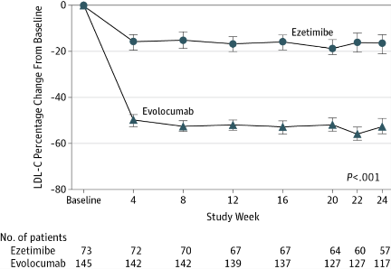
From: Efficacy and Tolerability of Evolocumab vs Ezetimibe in Patients With Muscle-Related Statin Intolerance: The GAUSS-3 Randomized Clinical Trial
JAMA. Published online April 03, 2016. doi:10.1001/jama.2016.3608
Figure Legend:
Mean Percent Change in Low-Density Lipoprotein Cholesterol Level During Randomized Treatment With Ezetimibe or Evolocumab, GAUSS-3 TrialEzetimibe dose, 10 mg daily; evolocumab dose, 140 mg 3 times monthly (420 mg total dosage). GAUSS-3 indicates Goal Achievement After Utilizing an Anti-PCSK9 Antibody in Statin Intolerant Subjects 3. Error bars indicate 95% CIs.
Date of download: 4/3/2016
Copyright © 2016 American Medical Association. All rights reserved.

Slide 40
Alirocumab Maintained Consistent LDL-C Reductions Over 52 Weeks
Achieved LDL-C Over Time All patients on background of maximally tolerated statin ± other lipid-lowering therapy
Alirocumab
Placebo
118.9 mg/dL (+0.8%)
123.0 mg/dL
(+4.4%)
Difference −61.9%
Difference −61.3%
Calculated LDL-C, LS mean (SE), mg/dL
53.1 mg/dL
(−56.8%)
48.3 mg/dL (−61.0%)
0
4
8
12
16
24
36
52
Week
Intent-to-treat (ITT) analysis
Notes:
The values indicated on the graph are achieved levels at Week 24 and 52.
Results shown are from the ITT analysis, which included all patients with a baseline and at least one post-baseline LDL-C measurement (regardless of treatment adherence). For the ITT analysis, all available measurements at planned time points from Weeks 4 to 52, whatever their status on or off-treatment, were used in the MMRM.
ITT, intent-to-treat; LS, least squares; LLT, lipid-lowering therapy; MMRM, mixed effect model with repeated measures; SE, standard error.

Slide 41
Glagov study Primary Endpoint: Percent Atheroma Volume
P = NS
P < 0.0001
P <0.0001
Statin monotherapy
Statin-evolocumab

Slide 42
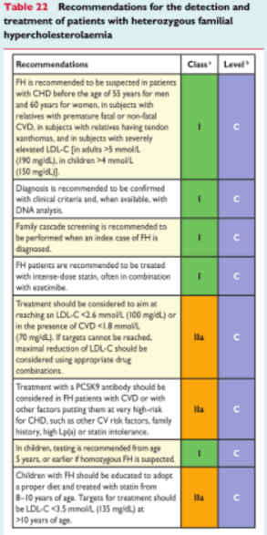

Slide 43
Uuringu nimi | Uuringuravim | Patsiendid | Esmane tulemusnäitaja | Uuringu pikkus
FOURIER | Evolokumab | 27 000 kardiovaskulaarhaigusega patsienti; LDL-C ≥1,8 mmol/L , maksimaalne statiinravi | KV surm, MI, hospitaliseerimine ebastabiilse rinnaangiini tõttu, koronaarreveskularisatsioon | 60 kuud
ODYSSEY OUTCOMES | Alirokumab | 18 000 haiget, äge koronaarsündroom alla 1 aasta tagasi; LDL-C ≥1,8 mmol/L , maksimaalne statiinravi | KV surm, mittefataalne MI, hospitaliseerimine ebastabiilse rinnaangiini tõttu, ajuinsult | 64 kuud
SPIRE-1 | Bococizumab | 17 000 kõrge kardiovaskulaarse riskiga haiget, primaarne või sekundaarne preventsioon; LDL-C ≥1,8 mmol/L , lipiidelangetav ravi | Aeg kardiovaskulaarse atakini (KV surm, mitte-fataalne MI, mittefataalne ajuinsult hospitaliseerimine ebastabiilse rinnaangiini tõttu) | 60 kuud
SPIRE-2 | Bococizumab | 9 000 kõrge kardiovaskulaarse riskiga haiget, LDL-C ≥2.58 mmol/L , lipiidelangetav ravi | Aeg kardiovaskulaarse atakini (KV surm, mitte-fataalne MI, mittefataalne ajuinsult hospitaliseerimine ebastabiilse rinnaangiini tõttu) | 60 kuud

Slide 44
FOURIER Further cardiovascular OUtcomes Research with PCSK9 Inhibition in subjects with Elevated Risk
MS Sabatine, RP Giugliano, AC Keech, N Honarpour, SM Wasserman, PS Sever, and TR Pedersen, for the FOURIER Steering Committee & Investigators
American College of Cardiology – 66th Annual Scientific Session
Late-Breaking Clinical Trial
March 17, 2017
Notes:
Global Review
QC/Data review performed
GDL reviewed (Ransi Somaratne)
Regional Review
Deck will need regional review (i.e. MAC)
Distribution
GDL approved for external distribution pending local/regional regulatory approval (i.e. US may be restricted to leave-behind by MedInfo only)
Annotations
Available in deck as “Notes Page” view

Slide 45
LDL Cholesterol
Placebo
59% mean reduction (95%CI 58-60), P<0.00001
Absolute reduction: 56 mg/dl (95%CI 55-57)
Evolocumab
(median 30 mg/dl, IQR 19-46 mg/dl)

Slide 46
Primary Endpoint
Hazard ratio 0.85
(95% CI, 0.79-0.92)
P<0.0001
14.6%
Placebo
12.6%
CV Death, MI, Stroke, Hosp for UA, or Cor Revasc
Evolocumab
0
6
12
18
24
30
36
Months from Randomization

Slide 47
Key Secondary Endpoint
9.9%
Hazard ratio 0.80
(95% CI, 0.73-0.88)
P<0.00001
7.9%
Placebo
CV Death, MI, or Stroke
Evolocumab
0
6
12
18
24
30
36
Months from Randomization

Slide 48
EBBINGHAUS: - A Cognitive Study of Patients Enrolled in the FOURIER Trial
RP Giugliano, F Mach, K Zavitz, AC Keech, TR Pedersen,
MS Sabatine, P Sever, C Kurtz, N Honarpour, BR Ott, on behalf of the EBBINGHAUS Investigators
American College of Cardiology – 66th Annual Scientific Session
Late-Breaking Clinical Trial
March 18, 2017
Notes:
Global Review
QC/Data review performed
GDL reviewed (Ransi Somaratne)
Regional Review
Deck will need regional review (i.e. MAC)
Distribution
This slide set may NOT be left behind
Annotations
Available in deck as “Notes Page” view

Slide 49
Primary Endpoint Spatial Working Memory Strategy Index
Non-inferiority boundary
0.19
P_{non-inferiority} <0.001
-0.10 0.0 0.10 0.20
Treatment Difference in Z score
(Placebo minus Evolocumab)
Favors Evolocumab Favors Placebo
Raw Scores
P_{NI} is from fixed estimate

Slide 50
Eesti Arsti artikkel aprill 2017

Slide 54
Disability-adjusted life years (DALYs) due to ischemic heart disease (per million people), 2015
Copyright © ESC

Slide 55
Tänan!

